Slide 1
BRITISH AIRWAY ANALYSIS
ANALYSING AIRLINE REVIEW FOR KEY INSIGHT

Slide 2
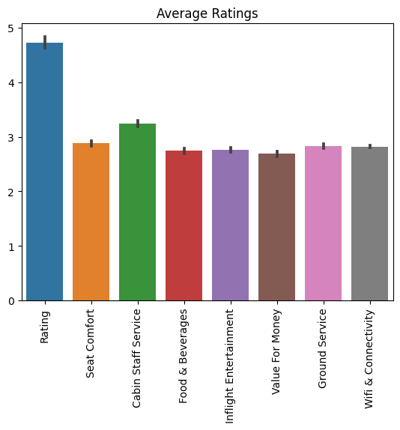
AVERAGE RATING
The Average Review Rating was about 5/10
For other services we offer such as food & beverage, ground service, value for money they all had rating close to 3/5

Slide 3
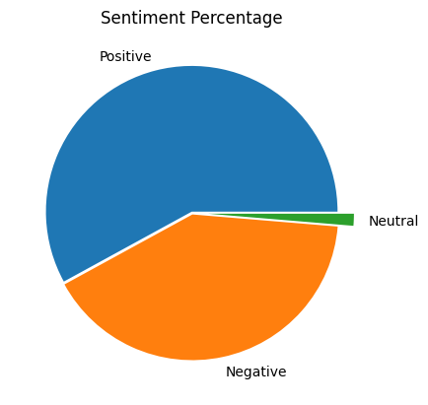
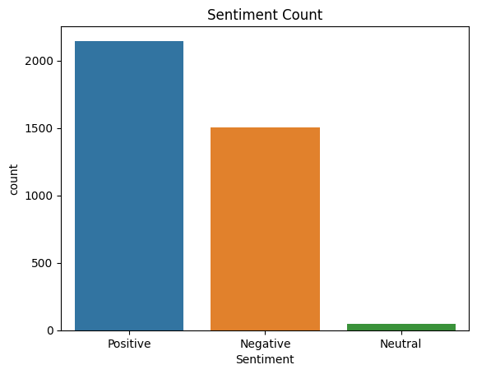
SENTIMENTS
There are 2146 Positive Reviews, 1507,Negative Reviews and 49 Neutral Reviews.

Slide 4
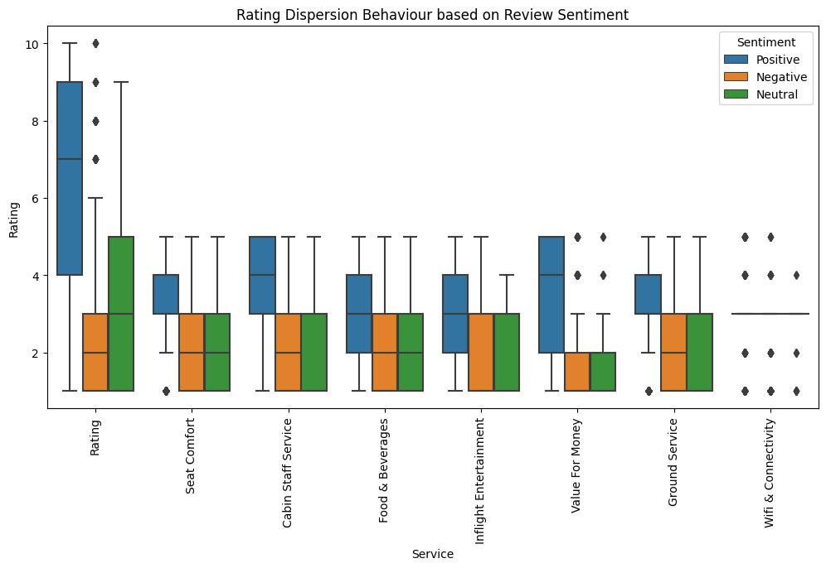
Rating Dispersion

Slide 5
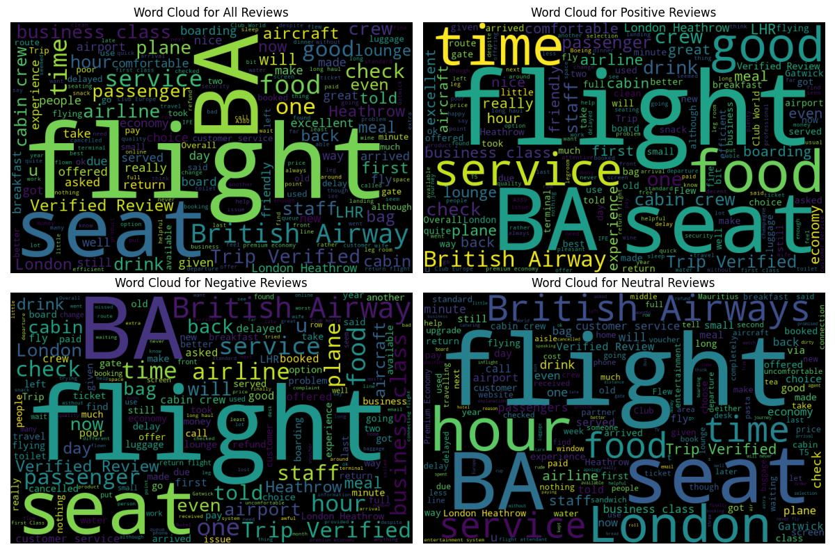
Word Cloud

Slide 6
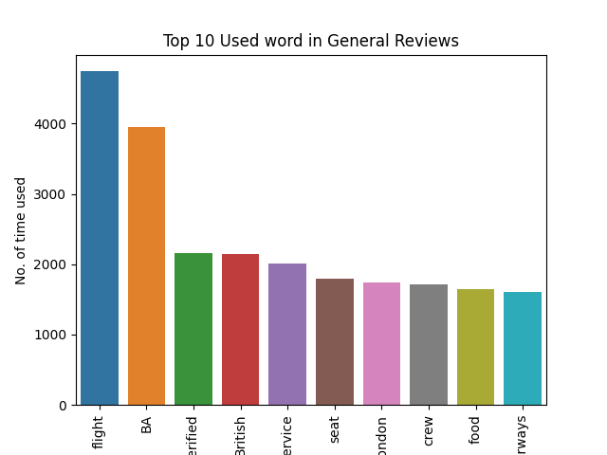
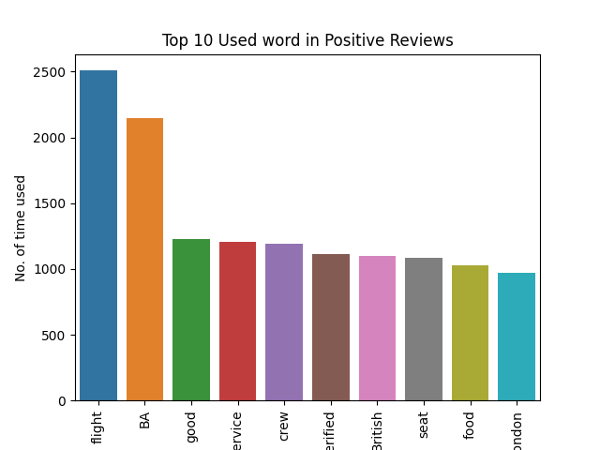
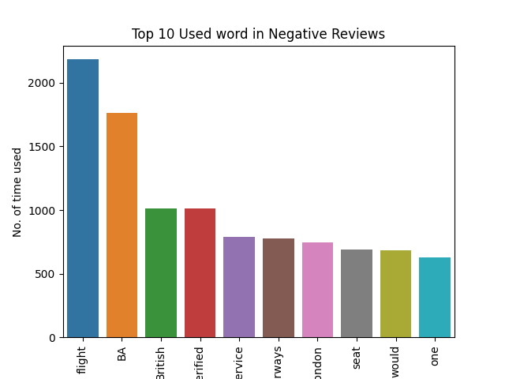
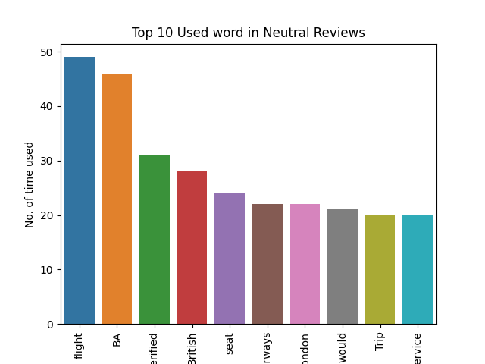
Frequent Word Used

